Slide 1

Depth Enhancement Tool & Structured-Depth Image Based Rendering
Pravin Kumar Rana
Sound and Image Processing Lab.(SIP)
KTH - Royal Institute of Technology
SE-10044 Stockholm, Sweden

Slide 2

Outline
Results
Depth Enhancement Tool
View Synthesis with Connection information
Rendering with Structured-Depth

Slide 3
Depth Enhancement Tool

Slide 4
Depth Enhancement Tool
MPEG Depth Maps (MPEG/D)
Depth Enhancement Tool
Enhanced Depth Maps (ED)

Slide 5
Depth Enhancement Tool
Depth Consistency Testing
Depth Enhancement Tool
Depth Consistency Testing Algorithm
(DCTA)
Multi-DCTA (MDCTA)
Testing pixels in 2
Testing pixels in 1, 2, and 3
MDCTA/ED

Slide 6
Depth Enhancement Tool
Depth Consistency Testing
Depth Enhancement Tool
Depth Consistency Testing Algorithm
(DCTA)
Multi-DCTA (MDCTA)
Testing pixels in 2
Testing pixels in 1, 2, and 3
MDCTA/ED

Slide 7
Depth Enhancement Tool
Depth Consistency Testing
Depth Enhancement Tool
Depth Consistency Testing Algorithm
(DCTA)
Multi-DCTA (MDCTA)
Testing pixels in 2
Testing pixels in 1, 2, and 3
MDCTA/ED

Slide 8
Depth Enhancement Tool
Motion
Estimation
Motion
Estimation
Motion-Compensated-MDCTA
(MC-MDCTA)
MC-MDCTA/ED

Slide 9
VSRS 3.5 Configuration file
The best VSRS parameters setting[1]:
1D Synthesis mode
Boundary Noise Removal off
View Blending off, not used in the 1D mode
Half-pel precision
Any setting for the Filter parameter
[1] Study of VSRS input parameters, Martin Pettersson, Ericsson, 2011-02-28

Slide 10
Results
MPEG/D → MDCTA/ED → VSRS 3.5
Sequence ID | Test Sequence | Spatial Resolution | No. Frames | Virtual View | MPEG/D→ VSRS 3.5 [dB] | MDCTA/ED→ VSRS 3.5 [dB]
S01 | Poznan Hall 2 | 1920x1088 | 200 | 6.5 | SE | SE⁽¹⁾
S02 | Poznan Street | 1920x1088 | 250 | 3.5 | SE | SE
S03 | Undo Dancer | 1920x1080 | 250 | 03 | 38.50 | 38.11⁽²⁾
S04 | GT Fly | 1920x1080 | 250 | 04 | x | x
S03 | Kendo | 1024x768 | 300 | 04 | 37.66 | 37.30⁽²⁾
S06 | Balloons | 1024x768 | 300 | 04 | 36.60 | 36.60
S07 | Lovebird1 | 1024x768 | 240 | 07 | 28.68 | 28.72
S07* | Lovebird1 | 1024x768 | 240 | 07 | 30.37 | 30.00
S08 | Newspaper | 1024x768 | 300 | 05 | 32.35 | 32.40⁽²⁾
Old mpeg depth maps
(1) Good subjective result
(2) Subjective improvement

Slide 11
Results
MPEG/D → MC-MDCTA/ED → VSRS 3.5
Sequence ID | Test Sequence | Spatial Resolution | No. Frames | Virtual View | MPEG/D→VSRS 3.5 [dB] | MDCTA/ED→VSRS 3.5 [dB] | MC-MDCTA /ED→ VSRS 3.5 [dB]
S01 | Poznan Hall 2 | 1920x1088 | 200 | 6.5 | SE | SE⁽¹⁾ | x
S02 | Poznan Street | 1920x1088 | 250 | 3.5 | SE | SE | x
S03 | Undo Dancer | 1920x1080 | 250 | 03 | 38.50 | 38.11⁽²⁾ | x
S04 | GT Fly | 1920x1080 | 250 | 04 | x | x | x
S03 | Kendo | 1024x768 | 300 | 04 | 37.66 | 37.30⁽²⁾ | 37.65
S06 | Balloons | 1024x768 | 300 | 04 | 36.60 | 36.60 | 36.74
S07 | Lovebird1 | 1024x768 | 240 | 07 | 28.68 | 28.72 | 28.72
S07* | Lovebird1 | 1024x768 | 240 | 07 | 30.37 | 30.00 | 30.30
S08 | Newspaper | 1024x768 | 300 | 05 | 32.35 | 32.40⁽²⁾ | x
Old mpeg depth maps
(1) Good subjective result
(2) Subjective improvement

Slide 12
Subjective Results
Poznan Hall2
Frame 157
MPEG/D → MDCTA/ED → VSRS 3.5
MPEG/D → VSRS 3.5

Slide 13
Subjective Results
Poznan Hall2
Frame 121
MPEG/D → VSRS 3.5
MPEG/D → MDCTA/ED → VSRS 3.5

Slide 14
Subjective Results
Undo Dancer 3
Frame 30
Original
MPEG/D → VSRS 3.5
MPEG/D → MDCTA/ED → VSRS 3.5

Slide 15
Subjective Results
Kendo 4
Frame 202
Original
MPEG/D → VSRS 3.5
MPEG/D → MDCTA/ED → VSRS 3.5

Slide 16
Subjective Results
Kendo 4
Frame 204
Original
MPEG/D → VSRS 3.5
MPEG/D → MDCTA/ED → VSRS 3.5

Slide 17
Subjective Results
Newspaper 5
Frame 85
Original
MPEG/D → VSRS 3.5
MPEG/D → MDCTA/ED → VSRS 3.5

Slide 18
Subjective Results
Newspaper 5
Frame 217
Original
MPEG/D → VSRS 3.5
MPEG/D → MDCTA/ED → VSRS 3.5

Slide 19
View Synthesis with Connection Information

Slide 20
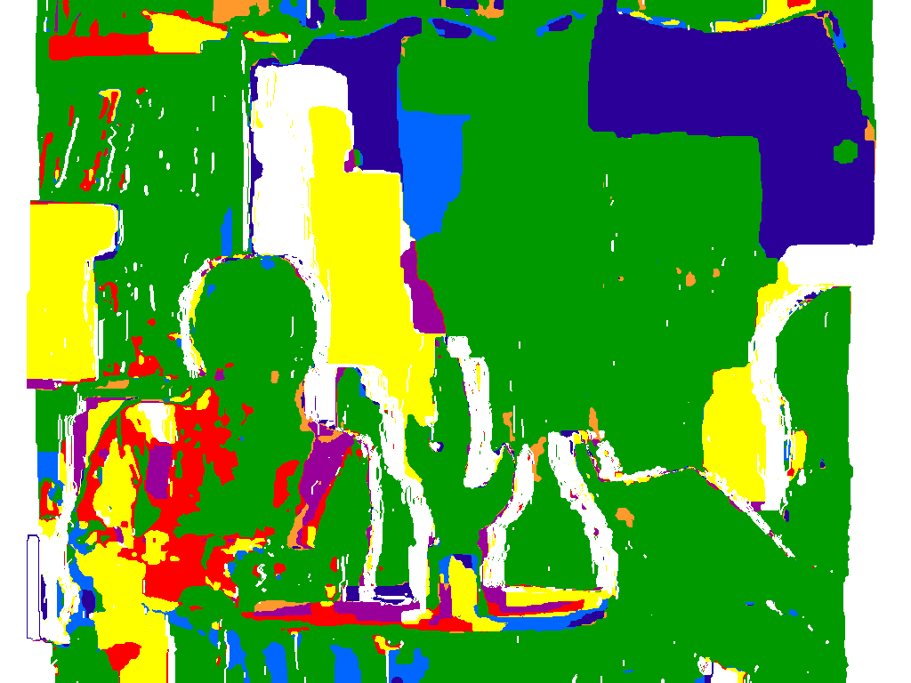
Inter-View Connection Information
Possible cases of inter-view connectivity for n = 3:
Use of Connection Information:
To obtain consistent depth values
To combine texture pixels from multiple viewpoint reliably

Slide 21
Depth Consistency Testing

Slide 22
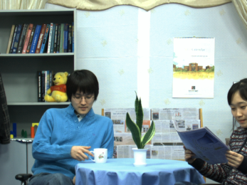

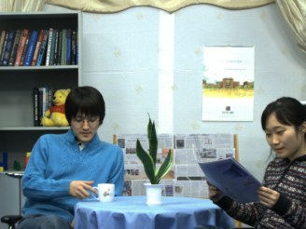
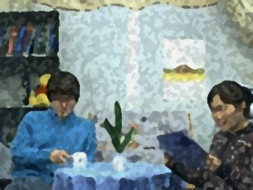
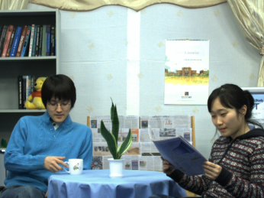
Virtual View Rendering
User
Free Viewpoint TV

Slide 23
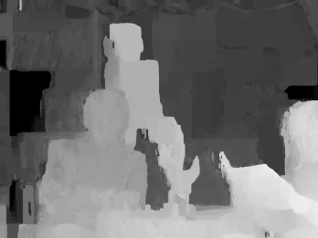
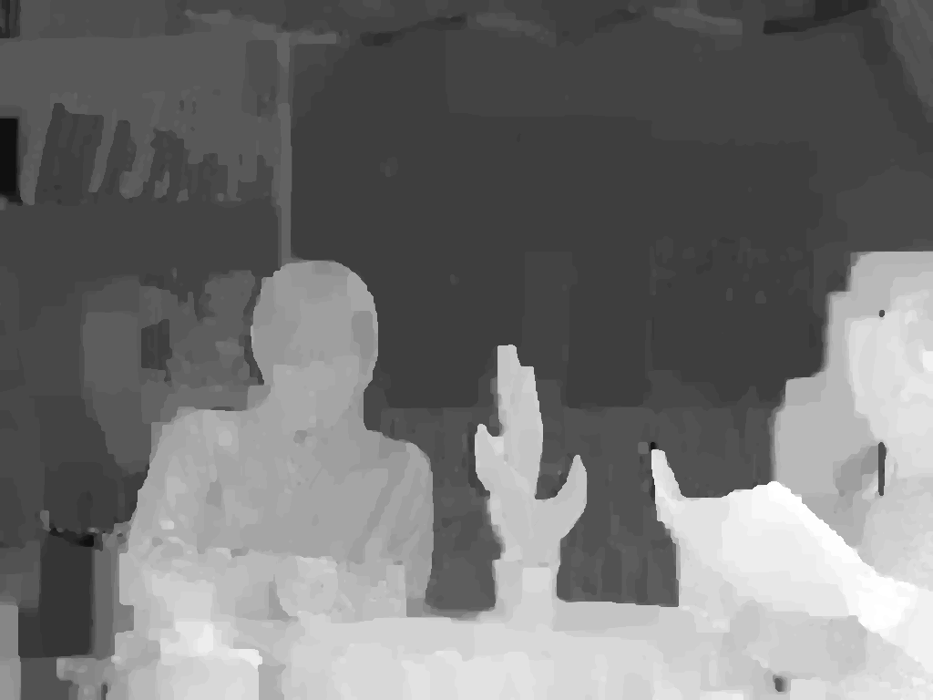
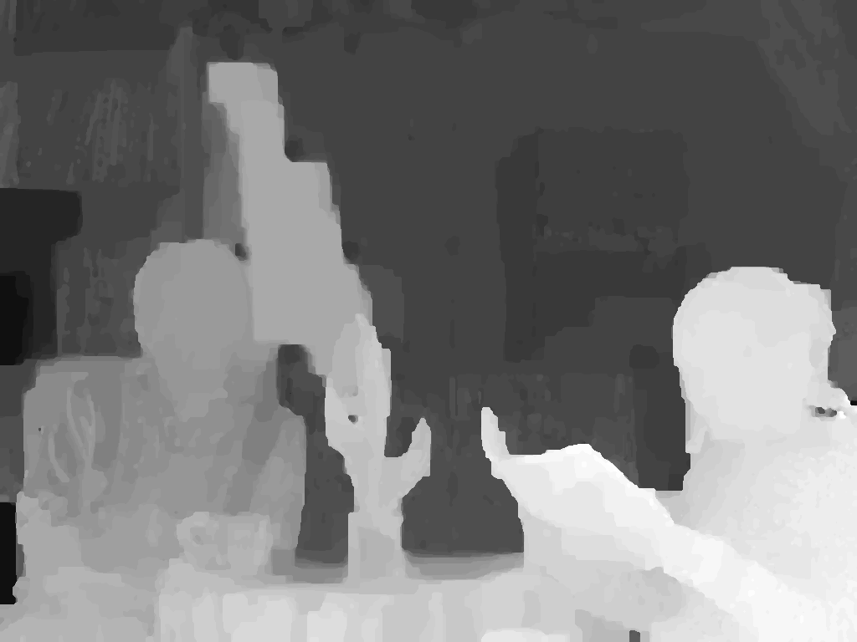
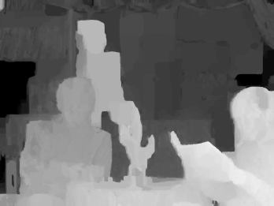
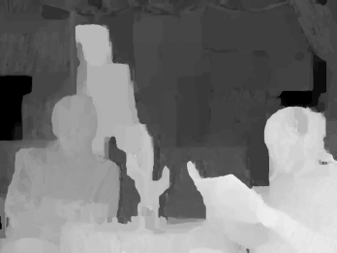
Virtual View Synthesis (VSRS+)
Enhanced depth maps
resulting from SDI

Slide 24

VSRS+
Multiview Texture

Slide 25
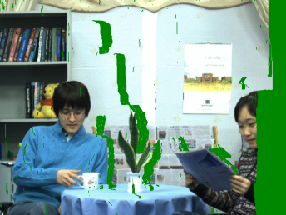
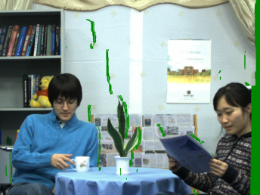
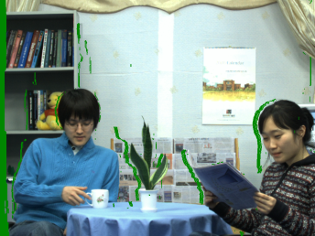
VSRS+
Warped views
at virtual viewpoint n
Warping
Warping
Warping
Slide 17

Slide 26
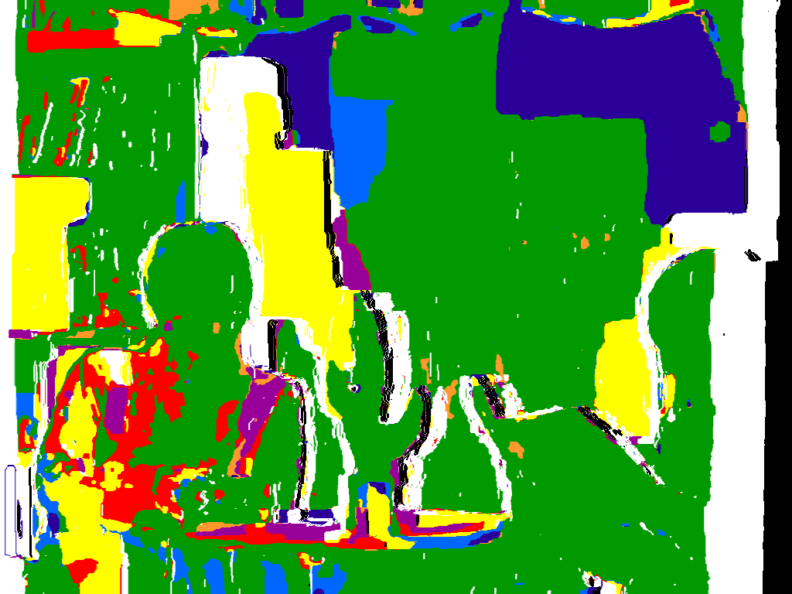
VSRS+
Warped views
at virtual viewpoint n
Warping
Warping
Masked Inter-view
Connection Information
Warping

Slide 27
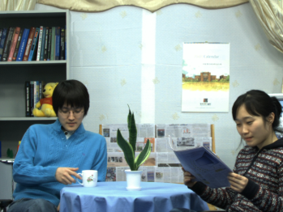
VSRS+
Warped views
at virtual viewpoint n
Warping
Warping
Connection-Adaptive
Pixel Intensity Estimation
Masked Inter-view
Connection Information
Warping

Slide 28
Results
MPEG/D→ MDCTA/ED → VSRS+
Sequence ID | Test Sequence | Spatial Resolution | No. Frames | Virtual View | MPEG/D→ VSRS 3.5 [dB] | MDCTA/ED→VSRS+
 |  |  |  |  |  | Adaptive Connection | Fixed Connection
S01 | Poznan Hall 2 | 1920x1088 | 200 | 6.5 | SE | SE | SE
S02 | Poznan Street | 1920x1088 | 250 | 3.5 | SE
S03 | Undo Dancer | 1920x1080 | 250 | 03 | 38.50 | 38.84 | 38.84
S04 | GT Fly | 1920x1080 | 250 | 04 | SE | x | x
S03 | Kendo | 1024x768 | 300 | 04 | 37.66 | 37.96 | 38.10
S06 | Balloons | 1024x768 | 300 | 04 | 36.63
S07 | Lovebird1 | 1024x768 | 240 | 07 | 28.68
S07* | Lovebird1 | 1024x768 | 240 | 07 | 30.37
S08 | Newspaper | 1024x768 | 300 | 05 | 32.35

Slide 29
Results
MPEG/D→ VSRS+
Sequence ID | Test Sequence | Spatial Resolution | No. Frames | Virtual View | MPEG/D→ VSRS 3.5 [dB] | MDCTA/ED→VSRS+ |  | MPEG/D→VSRS+
 |  |  |  |  |  | Adaptive Connection | Fixed Connection | Adaptive Connection
S01 | Poznan Hall 2 | 1920x1088 | 200 | 6.5 | SE | SE | SE | SE
S02 | Poznan Street | 1920x1088 | 250 | 3.5 | SE | SE | SE | SE
S03 | Undo Dancer | 1920x1080 | 250 | 03 | 38.50 | 38.84 | 38.84 | 39.46
S04 | GT Fly | 1920x1080 | 250 | 04 | SE | x | x | x
S03 | Kendo | 1024x768 | 300 | 04 | 37.66 | 37.96 | 38.10 | 38.13
S06 | Balloons | 1024x768 | 300 | 04 | 36.63 |  |  | 37.00
S07 | Lovebird1 | 1024x768 | 240 | 07 | 28.68 |  |  | 29.60
S07* | Lovebird1 | 1024x768 | 240 | 07 | 30.37 |  |  | 30.70
S08 | Newspaper | 1024x768 | 300 | 05 | 32.35 |  |  | 33.50

Slide 30
Results
MPEG/D→ MDCTA/ED → VSRS+
Sequence ID | Test Sequence | Spatial Resolution | No. Frames | Virtual View | MPEG/D→ VSRS 3.5 [dB] | MDCTA/ED→VSRS+
 |  |  |  |  |  | Adaptive Connection | Fixed Connection
S01 | Poznan Hall 2 | 1920x1088 | 200 | 6.5 | SE | SE | SE
S02 | Poznan Street | 1920x1088 | 250 | 3.5 | SE | SE | SE
S03 | Undo Dancer | 1920x1080 | 250 | 03 | 38.50 | 38.84 | 38.84
S04 | GT Fly | 1920x1080 | 250 | 04 | SE | x | x
S03 | Kendo | 1024x768 | 300 | 04 | 37.66 | 37.96 | 38.10
S06 | Balloons | 1024x768 | 300 | 04 | 36.63 | 36.88 | 36.89
S07 | Lovebird1 | 1024x768 | 240 | 07 | 28.68 | 29.37 | 29.85
S07* | Lovebird1 | 1024x768 | 240 | 07 | 30.37 | 30.50 | 30.81
S08 | Newspaper | 1024x768 | 300 | 05 | 32.35 | 34.10 | 34.43

Slide 31
Results
MPEG/D→ VSRS+
Sequence ID | Test Sequence | Spatial Resolution | No. Frames | Virtual View | MPEG/D→ VSRS 3.5 [dB] | MDCTA/ED→VSRS+ |  | MPEG/D→VSRS+
 |  |  |  |  |  | Adaptive Connection | Fixed Connection | Adaptive Connection
S01 | Poznan Hall 2 | 1920x1088 | 200 | 6.5 | SE | SE | SE | SE
S02 | Poznan Street | 1920x1088 | 250 | 3.5 | SE | SE | SE | SE
S03 | Undo Dancer | 1920x1080 | 250 | 03 | 38.50 | 38.84 | 38.84 | 39.46
S04 | GT Fly | 1920x1080 | 250 | 04 | SE | x | x | x
S03 | Kendo | 1024x768 | 300 | 04 | 37.66 | 37.96 | 38.10 | 38.13
S06 | Balloons | 1024x768 | 300 | 04 | 36.63 |  |  | 37.00
S07 | Lovebird1 | 1024x768 | 240 | 07 | 28.68 |  |  | 29.60
S07* | Lovebird1 | 1024x768 | 240 | 07 | 30.37 |  |  | 30.70
S08 | Newspaper | 1024x768 | 300 | 05 | 32.35 |  |  | 33.50

Slide 32
Subjective Results
Undo Dancer 3
Frame 30
Original
MPEG/D → VSRS 3.5
MPEG/D → VSRS+
MPEG/D → MDCTA/ED → VSRS+

Slide 33
Subjective Results
Poznan Hall2
Frame 159
MPEG/D → VSRS 3.5
MPEG/D → MDCTA/ED → VSRS+
MPEG/D → VSRS+

Slide 34
Subjective Results
Poznan Street
Frame 121
MPEG/D → VSRS 3.5
MPEG/D → MDCTA/ED → VSRS+
MPEG/D → VSRS+

Slide 35
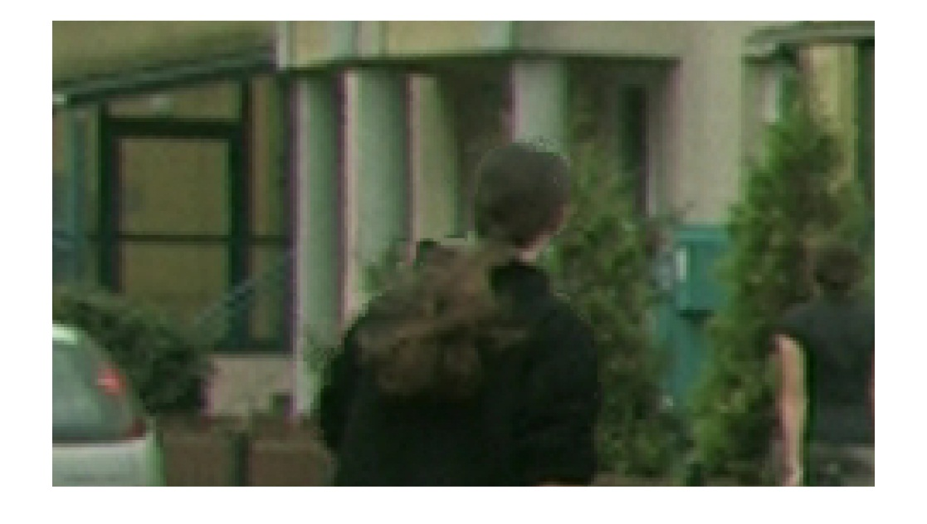
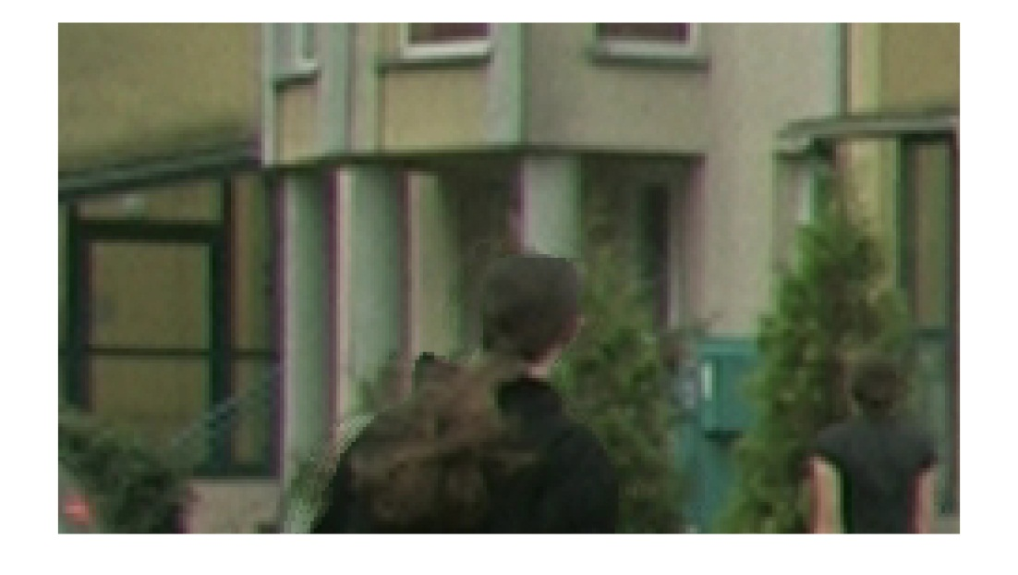
Subjective Results
Poznan Hall2
Frame 122
MPEG/D → VSRS 3.5
MPEG/D → MDCTA/ED → VSRS+
MPEG/D → VSRS+

Slide 36
Subjective Results
Poznan Street
Frame 250
MPEG/D → VSRS 3.5
MPEG/D→ VSRS+
MPEG/D → MDCTA/ED → VSRS+

Slide 37
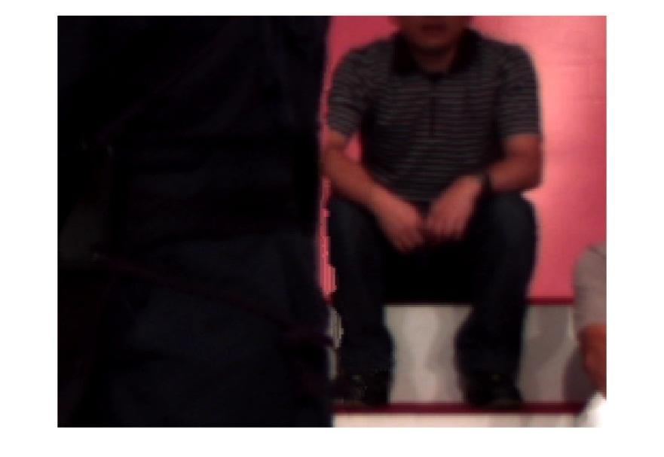
Subjective Results
Kendo 4
Frame 202
Original
MPEG/D → VSRS 3.5
MPEG/D → MDCTA/ED → VSRS+
MPEG/D → VSRS+

Slide 38
Rendering with Structured-Depth

Slide 39


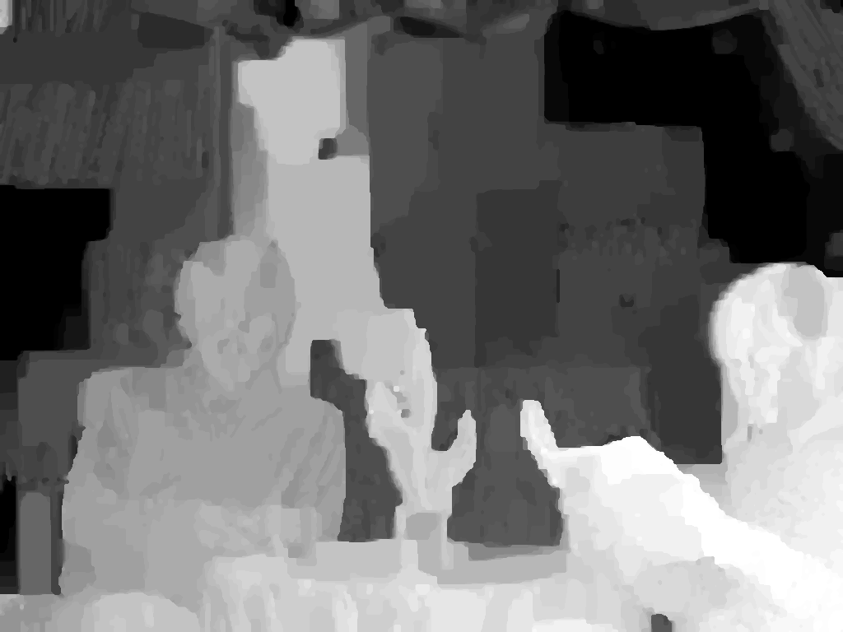
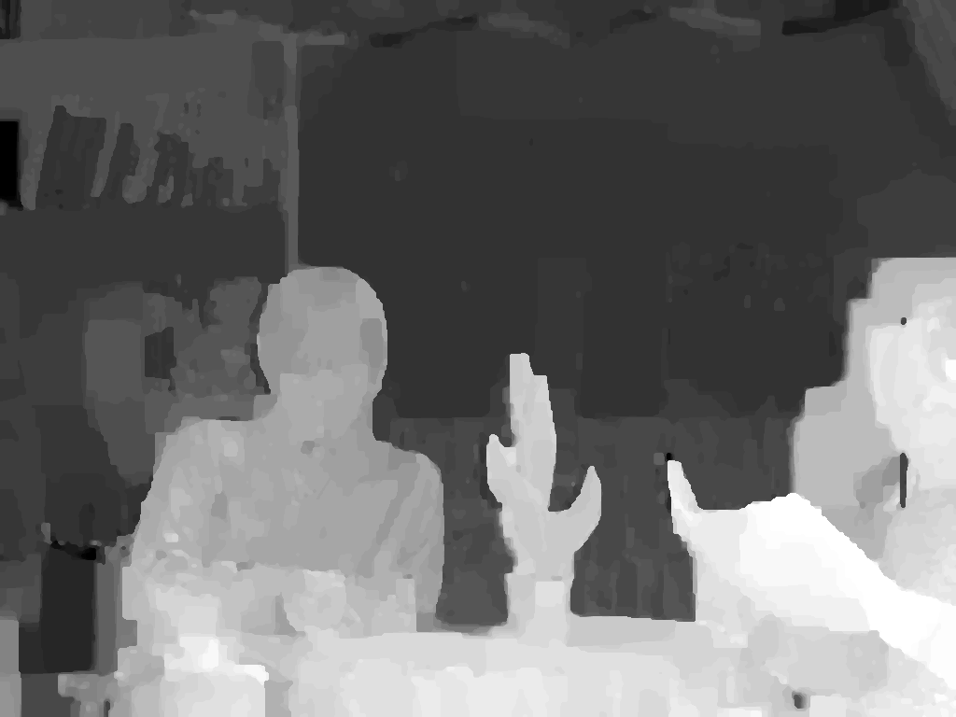
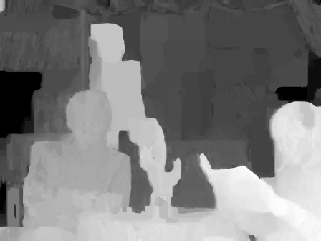
Principal Depth Map
Inter-view
Connection Information
Inter-view
connection Information
Depth Consistency Testing
Consistent Depth Values
Estimated Depth Maps
Principal Depth Map

Slide 40



Structured Depth Maps
Structured
Depth Map
,
,
,
,
=
Principal Depth Map
A set of auxiliary depth information at given
auxiliary points
Notes:
The cardinality |d| of the set d depends
on the number of reference views used for depth consistency
testing to obtain the principal depth map dp. Let dr , r ∈ {1, . . . ,n},
represent an arbitrary reference depth map from viewpoint r which
is used in the depth consistency testing to obtain a principal depth
map at viewpoint p. The cardinality of the set d is defined by
|d| =
(n−1) if p = r, ∀ r,
n if p = r, ∀ r, (4)
where n is the number of reference views used in the depth consistency
testing

Slide 41
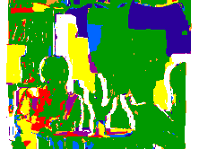


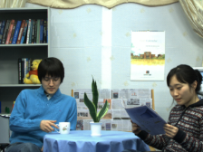
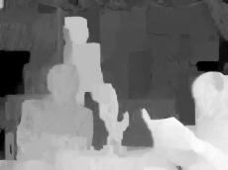
Rendering with Structured Depth Maps
Inter-view
connection information
Reconstructing Depth
VSRS+
Structured
Depth Maps
Virtual View
Notes:
The cardinality |d| of the set d depends
on the number of reference views used for depth consistency
testing to obtain the principal depth map dp. Let dr , r ∈ {1, . . . ,n},
represent an arbitrary reference depth map from viewpoint r which
is used in the depth consistency testing to obtain a principal depth
map at viewpoint p. The cardinality of the set d is defined by
|d| =
(n−1) if p = r, ∀ r,
n if p = r, ∀ r, (4)
where n is the number of reference views used in the depth consistency
testing

Slide 42
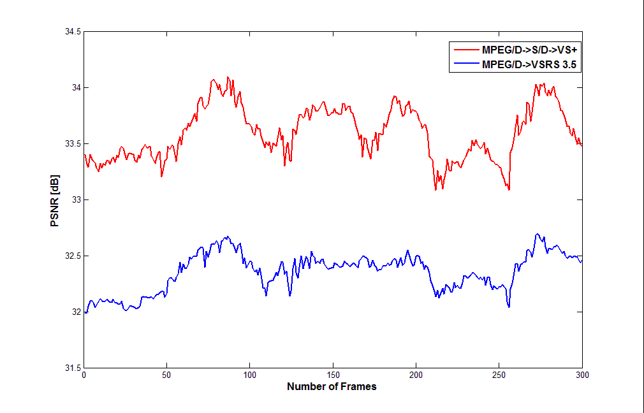
Results
MPEG/D→S/D→VSRS+
MPEG/D->S/D->VSRS+
MPEG/D->VSRS+
Newspaper 5

Slide 43
Results
MPEG/D→ S/D → VSRS+
Sequence ID | Test Sequence | Spatial Resolution | No. Frames | Virtual View | MPEG/D→ VSRS 3.5 [dB] | MDCTA/ED→VSRS+ |  | MPEG/D→ VSRS+ | MPEG/D→S/D→VSRS+
 |  |  |  |  |  | Adaptive Connection | Fixed Connection | Adaptive Connection | Adaptive Connection | Fixed Connection
S01 | Poznan Hall 2 | 1920x1088 | 200 | 6.5 | SE | SE | SE | SE | SE | SE
S02 | Poznan Street | 1920x1088 | 250 | 3.5 | SE | SE | SE | SE | SE | SE
S03 | Undo Dancer | 1920x1080 | 250 | 03 | 38.50 | 38.84 | 38.84 | 39.46 | 38.86 | 38.86
S04 | GT Fly | 1920x1080 | 250 | 04 | SE | x | x | x | x | x
S03 | Kendo | 1024x768 | 300 | 04 | 37.66 | 37.96 | 38.10 | 38.13 | 37.79 | 37.82
S06 | Balloons | 1024x768 | 300 | 04 | 36.63 |  |  | 37.00 | 36.60 | 36.56
S07 | Lovebird1 | 1024x768 | 240 | 07 | 28.68 |  |  | 29.60 | 29.50 | 30.00
S07* | Lovebird1 | 1024x768 | 240 | 07 | 30.37 |  |  | 30.70 | 30.32 | 30.34
S08 | Newspaper | 1024x768 | 300 | 05 | 32.35 |  |  | 33.50 | 33.60 | 33.90

Slide 44
Subjective Results
Adaptive VSRS+
vs.
Fixed VSRS+
MPEG/D →S/D → VSRS+: Fixed
MPEG/D → S/D → VSRS+:Adaptive
Newspaper 5
Frame 105

Slide 45
Subjective Results
Poznan Hall2
Frame 151
MPEG/D → S/D → VSRS+
MPEG/D → VSRS 3.5

Slide 46
Subjective Results
Poznan Hall2
Frame 121
MPEG/D → VSRS 3.5
MPEG/D → S/D → VSRS+

Slide 47
Subjective Results
Poznan Street
Frame 250
MPEG/D → S/D → VSRS+
MPEG/D → VSRS 3.5

Slide 48
Subjective Results
Undo Dancer 3
Frame 30
Original
MPEG/D → VSRS 3.5
MPEG/D → S/D → VSRS 3.5

Slide 49
Subjective Results
Kendo 4
Frame 202
Original
MPEG/D → VSRS 3.5
MPEG/D → S/D → VSRS 3.5

Slide 50
Subjective Results
Kendo 4
Frame 204
Original
MPEG/D → VSRS 3.5
MPEG/D → S/D → VSRS 3.5

Slide 51
Subjective Results
Kendo 4
Frame 204
Original
MPEG/D → VSRS 3.5
MPEG/D → S/D → VSRS 3.5

Slide 52
Subjective Results
Kendo 4
Frame 204
Original
MPEG/D → VSRS 3.5
MPEG/D → S/D → VSRS 3.5

Slide 53
Thank You

Slide 54
View Synthesis Using Structured Depth Images (VSRS+)
Multiview Video
Multiview Video
Inter-View Connection Information
Storage/
Transmission
Medium
Structured-Depth-Image-Based
Rendering
Structured Depth Estimation
Inter-View Connection Information
3D Scene Representation
Display
Structured Depth Maps
Structured Depth Maps

Slide 55
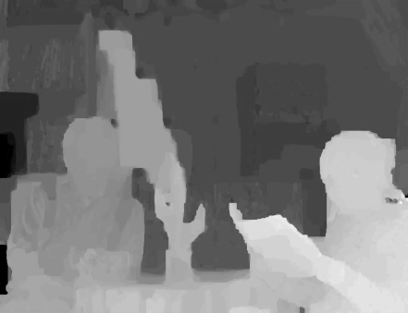



Extraction of Auxiliary Depth
Extraction
Reference Depth Map
Auxiliary Depth
Warping
Principal Depth Map
Occlusion Mask

Slide 56
Experiments
Multiview Video
Inter-view Connection
Connection Masking
Multiple Depth Maps
Depth Consistency Testing
3D Warping
&
Hole Filling
Multiview Virtual Video
Principal
Depth Map
Auxiliary Depth Info.

Slide 57
Subjective Results
Undo Dancer 3
Frame 30
Original
MPEG/D → VSRS 3.5
MPEG/D → MDCTA/D → VSRS 3.5
MPEG/D → S/D → VSRS+

